Slide 1
Divide-and-Conquer Technique: Merge Sort

Slide 2
Divide-and-Conquer
Divide-and-Conquer is a general algorithm design paradigm:
Divide the problem into a number of subproblems that are smaller instances of the same problem
Conquer the subproblems by solving them recursively
Combine the solutions to the subproblems into the solution for the original problem
The base case for the recursion are subproblems of constant size
Analysis can be done using recurrence equations

Slide 3
Divide-and-Conquer
a problem of size n
subproblem 1 of size n/2
subproblem 2 of size n/2
a solution to subproblem 1
a solution to subproblem 2
a solution to
the original problem
Lecturer Saifur Rahman, Dept. of CSE, United International University

Slide 4
Divide-and-Conquer
a problem of size n
subproblem 1 of size n/2
subproblem 2 of size n/2
Divide
a solution to subproblem 1
a solution to subproblem 2
a solution to
the original problem
Lecturer Saifur Rahman, Dept. of CSE, United International University

Slide 5
Merge Sort and Quick Sort
Two well-known sorting algorithms adopt this divide-and-conquer strategy
Merge sort
Divide step is trivial – just split the list into two equal parts
Work is carried out in the conquer step by merging two sorted lists
Quick sort
Work is carried out in the divide step using a pivot element
Conquer step is trivial

Slide 6
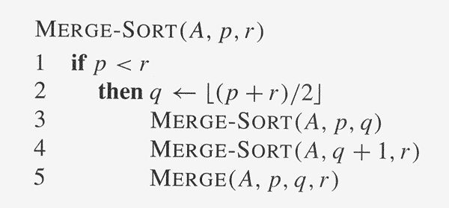
Merge Sort: Algorithm

Slide 7
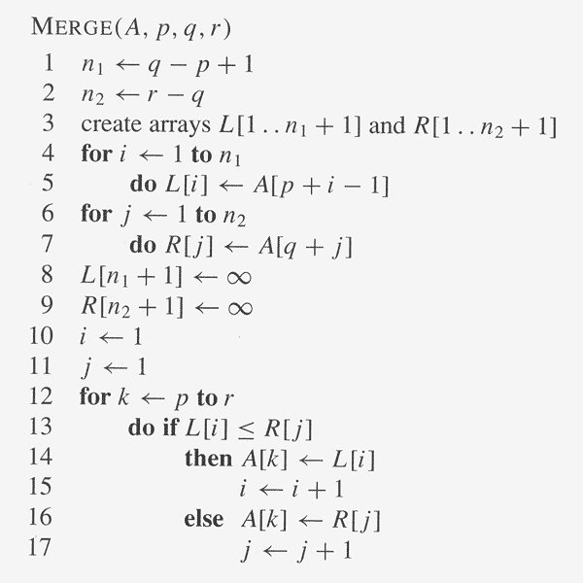
Merge Sort: Algorithm

Slide 8
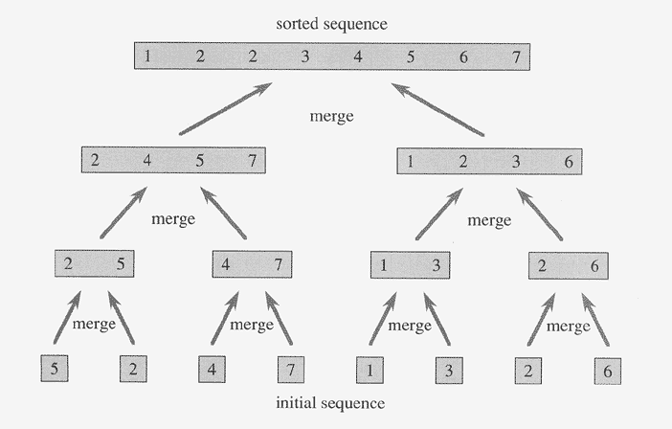
Merge Sort: Example

Slide 9
Execution Example
Partition
7 2 9 4 ⏐ 3 8 6 1 → 1 2 3 4 6 7 8 9
7 2 9 4 → 2 4 7 9
3 8 6 1 → 1 3 8 6
7 2 → 2 7
9 4 → 4 9
3 8 → 3 8
6 1 → 1 6
7 → 7
2 → 2
9 → 9
4 → 4
3 → 3
8 → 8
6 → 6
1 → 1
Merge Sort
9

Slide 10
Execution Example
Recursive call, partition
7 2 9 4 ⏐ 3 8 6 1 → 1 2 3 4 6 7 8 9
7 2 ⏐ 9 4 → 2 4 7 9
3 8 6 1 → 1 3 8 6
7 2 → 2 7
9 4 → 4 9
3 8 → 3 8
6 1 → 1 6
7 → 7
2 → 2
9 → 9
4 → 4
3 → 3
8 → 8
6 → 6
1 → 1
Merge Sort
10

Slide 11
Execution Example
Recursive call, partition
7 2 9 4 ⏐ 3 8 6 1 → 1 2 3 4 6 7 8 9
7 2 ⏐ 9 4 → 2 4 7 9
3 8 6 1 → 1 3 8 6
7 ⏐ 2 → 2 7
9 4 → 4 9
3 8 → 3 8
6 1 → 1 6
7 → 7
2 → 2
9 → 9
4 → 4
3 → 3
8 → 8
6 → 6
1 → 1
Merge Sort
11

Slide 12
Execution Example
Recursive call, base case
7 2 9 4 ⏐ 3 8 6 1 → 1 2 3 4 6 7 8 9
7 2 ⏐ 9 4 → 2 4 7 9
3 8 6 1 → 1 3 8 6
7 ⏐ 2 → 2 7
9 4 → 4 9
3 8 → 3 8
6 1 → 1 6
7 → 7
2 → 2
9 → 9
4 → 4
3 → 3
8 → 8
6 → 6
1 → 1
Merge Sort
12

Slide 13
Execution Example
Recursive call, base case
7 2 9 4 ⏐ 3 8 6 1 → 1 2 3 4 6 7 8 9
7 2 ⏐ 9 4 → 2 4 7 9
3 8 6 1 → 1 3 8 6
7 ⏐ 2 → 2 7
9 4 → 4 9
3 8 → 3 8
6 1 → 1 6
7 → 7
2 → 2
9 → 9
4 → 4
3 → 3
8 → 8
6 → 6
1 → 1
Merge Sort
13

Slide 14
Execution Example
Merge
7 2 9 4 ⏐ 3 8 6 1 → 1 2 3 4 6 7 8 9
7 2 ⏐ 9 4 → 2 4 7 9
3 8 6 1 → 1 3 8 6
7 ⏐ 2 → 2 7
9 4 → 4 9
3 8 → 3 8
6 1 → 1 6
7 → 7
2 → 2
9 → 9
4 → 4
3 → 3
8 → 8
6 → 6
1 → 1
Merge Sort
14

Slide 15
Execution Example
Recursive call, …, base case, merge
7 2 9 4 ⏐ 3 8 6 1 → 1 2 3 4 6 7 8 9
7 2 ⏐ 9 4 → 2 4 7 9
3 8 6 1 → 1 3 8 6
7 ⏐ 2 → 2 7
9 4 → 4 9
3 8 → 3 8
6 1 → 1 6
7 → 7
2 → 2
9 → 9
4 → 4
3 → 3
8 → 8
6 → 6
1 → 1
Merge Sort
15

Slide 16
Execution Example
Merge
7 2 9 4 ⏐ 3 8 6 1 → 1 2 3 4 6 7 8 9
7 2 ⏐ 9 4 → 2 4 7 9
3 8 6 1 → 1 3 8 6
7 ⏐ 2 → 2 7
9 4 → 4 9
3 8 → 3 8
6 1 → 1 6
7 → 7
2 → 2
9 → 9
4 → 4
3 → 3
8 → 8
6 → 6
1 → 1
Merge Sort
16

Slide 17
Execution Example
Recursive call, …, merge, merge
7 2 9 4 ⏐ 3 8 6 1 → 1 2 3 4 6 7 8 9
7 2 ⏐ 9 4 → 2 4 7 9
3 8 6 1 → 1 3 6 8
7 ⏐ 2 → 2 7
9 4 → 4 9
3 8 → 3 8
6 1 → 1 6
7 → 7
2 → 2
9 → 9
4 → 4
3 → 3
8 → 8
6 → 6
1 → 1
Merge Sort
17

Slide 18
Execution Example
Merge
7 2 9 4 ⏐ 3 8 6 1 → 1 2 3 4 6 7 8 9
7 2 ⏐ 9 4 → 2 4 7 9
3 8 6 1 → 1 3 6 8
7 ⏐ 2 → 2 7
9 4 → 4 9
3 8 → 3 8
6 1 → 1 6
7 → 7
2 → 2
9 → 9
4 → 4
3 → 3
8 → 8
6 → 6
1 → 1
Merge Sort
18

Slide 19
Merge Sort: Running Time
The recurrence for the worst-case running time T(n) is
T(n) = Θ(1) if n = 1
2T(n/2) + Θ(n) if n > 1
equivalently
T(n) = b if n = 1
2T(n/2) + bn if n > 1
Solve this recurrence by
(1) iteratively expansion
(2) using the recursion tree

Slide 20
Merge Sort: Running Time (Iterative Expansion)
Note that base, T(n) =b, case occurs when 2^{i} = n.
That is, i = log n.
So,
Thus, T(n) is O(n log n).

Slide 21
Merge Sort: Running Time (Recursion Tree)
Draw the recursion tree for the recurrence relation and look for a pattern:
depth | T’s | size
0 | 1 | n
1 | 2 | n/2
i | 2^{i} | n/2^{i}
… | … | …
time
bn
bn
bn
…
Total time = bn + bn log n
(last level plus all previous levels)

